Slide 1
More Applications of the Pumping Lemma
Costas Busch - RPI

Slide 2









The Pumping Lemma:
Given a infinite regular language
there exists an integer
for any string with length
we can write
with and
such that:
Costas Busch - RPI

Slide 3
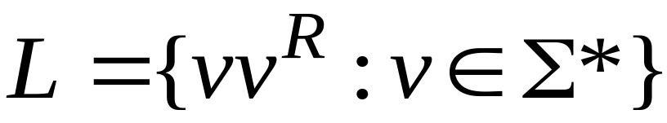
Non-regular languages
Regular languages
Costas Busch - RPI

Slide 4

Theorem:
The language
is not regular
Proof:
Use the Pumping Lemma
Costas Busch - RPI

Slide 5
Assume for contradiction
that is a regular language
Since is infinite
we can apply the Pumping Lemma
Costas Busch - RPI

Slide 6


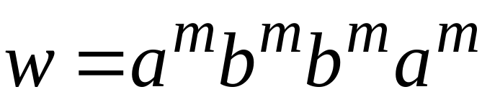
Let be the integer in the Pumping Lemma
Pick a string such that:
and
length
We pick
Costas Busch - RPI

Slide 7
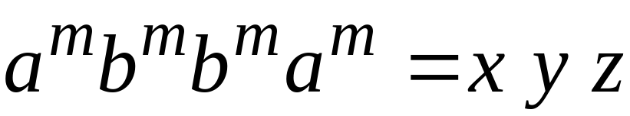




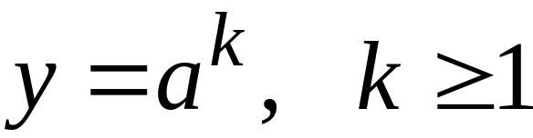
Write
From the Pumping Lemma
it must be that length
Thus:
Costas Busch - RPI

Slide 8
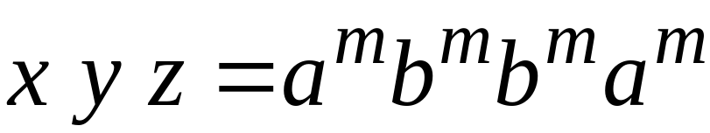

From the Pumping Lemma:
Thus:
Costas Busch - RPI

Slide 9

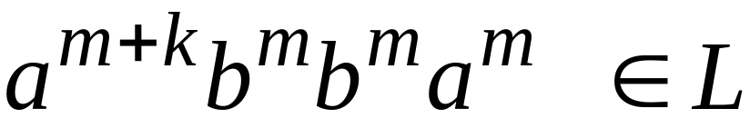
From the Pumping Lemma:
Thus:
Costas Busch - RPI

Slide 10

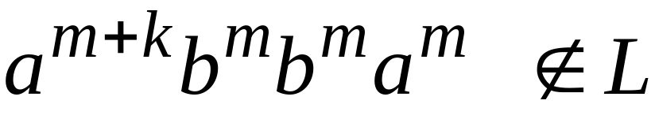
BUT:
CONTRADICTION!!!
Costas Busch - RPI

Slide 11
Therefore:
Our assumption that
is a regular language is not true
Conclusion:
is not a regular language
Costas Busch - RPI

Slide 12

Non-regular languages
Regular languages
Costas Busch - RPI

Slide 13
Theorem:
The language
is not regular
Proof:
Use the Pumping Lemma
Costas Busch - RPI

Slide 14
Assume for contradiction
that is a regular language
Since is infinite
we can apply the Pumping Lemma
Costas Busch - RPI

Slide 15
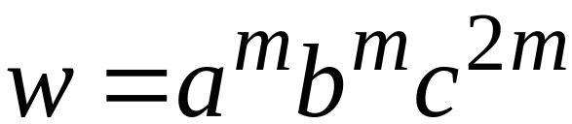
Let be the integer in the Pumping Lemma
Pick a string such that:
and
length
We pick
Costas Busch - RPI

Slide 16
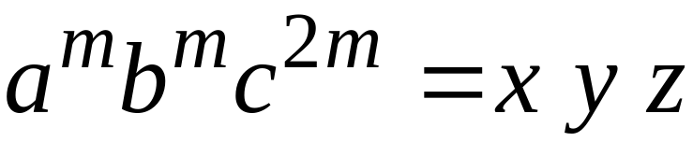

Write
From the Pumping Lemma
it must be that length
Thus:
Costas Busch - RPI

Slide 17
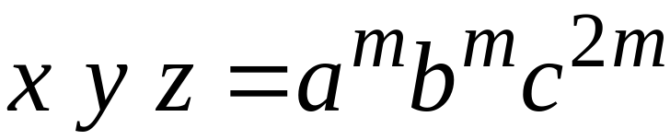
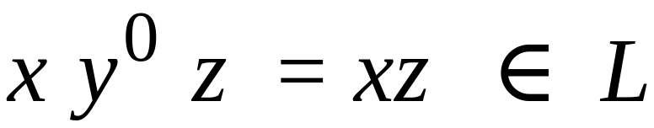
From the Pumping Lemma:
Thus:
Costas Busch - RPI

Slide 18
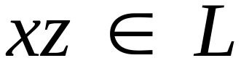

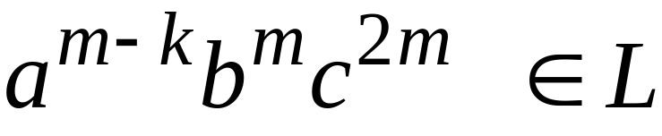
From the Pumping Lemma:
Thus:
Costas Busch - RPI

Slide 19
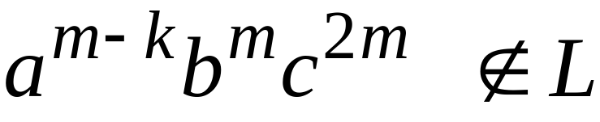
BUT:
CONTRADICTION!!!
Costas Busch - RPI

Slide 20
Therefore:
Our assumption that
is a regular language is not true
Conclusion:
is not a regular language
Costas Busch - RPI

Slide 21
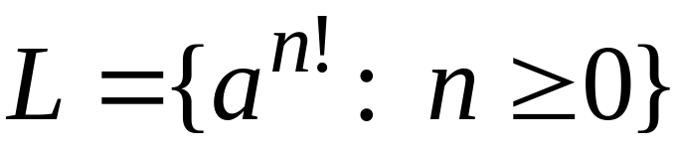
Non-regular languages
Regular languages
Costas Busch - RPI

Slide 22
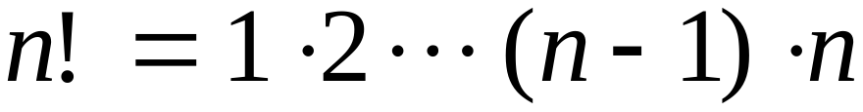
Theorem:
The language
is not regular
Proof:
Use the Pumping Lemma
Costas Busch - RPI

Slide 23
Assume for contradiction
that is a regular language
Since is infinite
we can apply the Pumping Lemma
Costas Busch - RPI

Slide 24
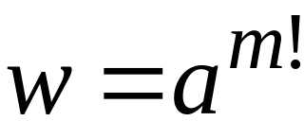
Let be the integer in the Pumping Lemma
Pick a string such that:
length
We pick
Costas Busch - RPI

Slide 25
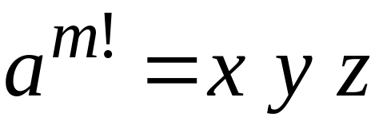

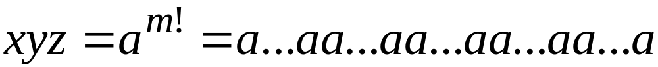
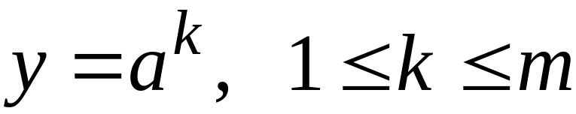
Write
From the Pumping Lemma
it must be that length
Thus:
Costas Busch - RPI

Slide 26
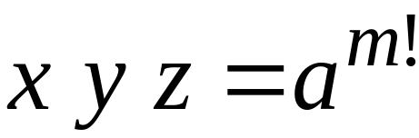
From the Pumping Lemma:
Thus:
Costas Busch - RPI

Slide 27

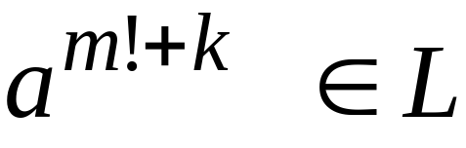
From the Pumping Lemma:
Thus:
Costas Busch - RPI

Slide 28
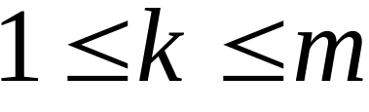

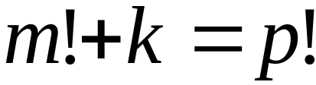
Since:
There must exist such that:
Costas Busch - RPI

Slide 29

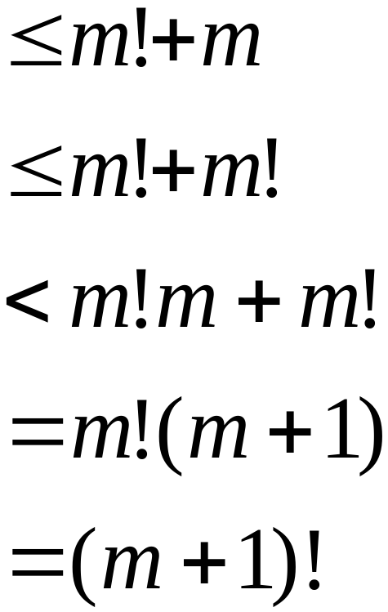

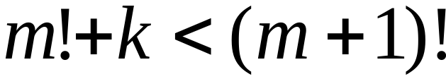
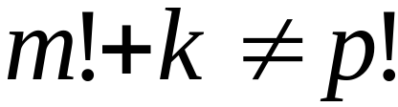
However:
for
for any
Costas Busch - RPI

Slide 30
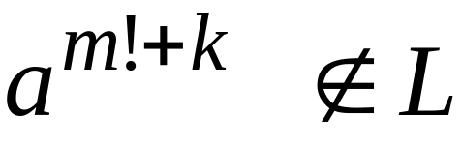
BUT:
CONTRADICTION!!!
Costas Busch - RPI

Slide 31
Therefore:
Our assumption that
is a regular language is not true
Conclusion:
is not a regular language
Costas Busch - RPI

Slide 32
Lex
Costas Busch - RPI

Slide 33
Lex: a lexical analyzer
A Lex program recognizes strings
For each kind of string found
the lex program takes an action
Costas Busch - RPI

Slide 34
Output
Identifier: Var
Operand: =
Integer: 12
Operand: +
Integer: 9
Semicolumn: ;
Keyword: if
Parenthesis: (
Identifier: test
....
Input
Var = 12 + 9;
if (test > 20)
temp = 0;
else
while (a < 20)
temp++;
Lex
program
Costas Busch - RPI

Slide 35
In Lex strings are described
with regular expressions
Lex program
Regular expressions
“+”
“-”
“=“
/* operators */
“if”
“then”
/* keywords */
Costas Busch - RPI

Slide 36
Lex program
Regular expressions
(0|1|2|3|4|5|6|7|8|9)+
/* integers */
(a|b|..|z|A|B|...|Z)+
/* identifiers */
Costas Busch - RPI

Slide 37
integers
(0|1|2|3|4|5|6|7|8|9)+
[0-9]+
Costas Busch - RPI

Slide 38
identifiers
(a|b|..|z|A|B|...|Z)+
[a-zA-Z]+
Costas Busch - RPI

Slide 39
Each regular expression
has an associated action (in C code)
Examples:
Regular expression
Action
\n
linenum++;
[0-9]+
prinf(“integer”);
[a-zA-Z]+
printf(“identifier”);
Costas Busch - RPI

Slide 40
Default action: ECHO;
Prints the string identified
to the output
Costas Busch - RPI

Slide 41
A small lex program
%%
[ \t\n] ; /*skip spaces*/
[0-9]+
printf(“Integer\n”);
[a-zA-Z]+
printf(“Identifier\n”);
Costas Busch - RPI

Slide 42
Output
Input
Integer
Identifier
Identifier
Integer
Integer
Integer
1234 test
var 566 78
9800
Costas Busch - RPI

Slide 43
%{
int linenum = 1;
%}
Another program
%%
[ \t] ; /*skip spaces*/
\n
linenum++;
[0-9]+
prinf(“Integer\n”);
[a-zA-Z]+
printf(“Identifier\n”);
.
printf(“Error in line: %d\n”,
linenum);
Costas Busch - RPI

Slide 44
Output
Input
Integer
Identifier
Identifier
Integer
Integer
Integer
Error in line: 3
Identifier
1234 test
var 566 78
9800 +
temp
Costas Busch - RPI

Slide 45
Lex matches the longest input string
Example:
Regular Expressions
“if”
“ifend”
Input:
ifend if
Matches: “ifend” “if”
Costas Busch - RPI

Slide 46
Internal Structure of Lex
Lex
Regular
expressions
Minimal
DFA
NFA
DFA
The final states of the DFA are
associated with actions
Costas Busch - RPI

